Slide 1
PREAMBLE
Dr.P.DEVI

Slide 2
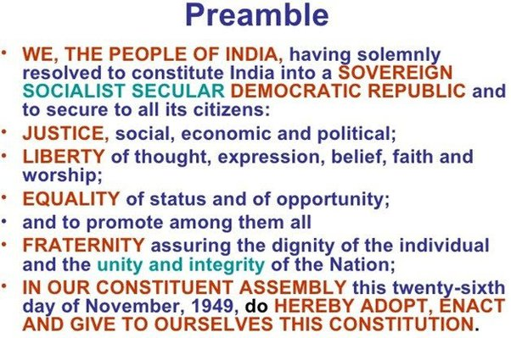

Slide 3
Preamble
The Preamble, in brief, explains the objectives of the Constitution in two ways:
one, about the structure of the governance and
the other, about the ideals to be achieved in independent India. It is because of this, the Preamble is considered to be the key of the Constitution.

Slide 4
The objectives, which are laid down in the Preamble, are:
i) Description of Indian State as Sovereign, Socialist, Secular, Democratic Republic.
(Socialist, Secular added by 42nd Amendment, 1976).
ii) Provision to all the citizens of India i.e.,
a) Justice social, economic and political
b) Liberty of thought, expression, belief, faith and worship
c) Equality of status and opportunity
d) Fraternity assuring dignity of the individual and unity and integrity of the nation.

Slide 5
Sovereignty
Sovereignty is one of the foremost elements of any independent State. It means absolute independence, i.e., a government which is not controlled by any other power: internal or external.
A country cannot have its own constitution without being sovereign. India is a sovereign country. It is free from external control. It can frame its policies. India is free to formulate its own foreign policy.

Slide 6
Socialist
The word socialist was not there in the Preamble of the Constitution in its original form.
The term socialist has been inserted into the preamble by the Constitution 42nd Amendment Act, 1976.
The word ‘Socialism’ had been used in the context of economic planning. It signifies major role in the economy. It also means commitment to attain ideals like removal of inequalities, provision of minimum basic necessities to all, equal pay for equal work..

Slide 7
Secularism
In the context of secularism in India, it is said that ‘India is neither religious, nor irreligious nor anti-religious.’
Now what does this imply?
It implies that in India there will be no ‘State’ religion – the ‘State’ will not support any particular religion out of public fund.

Slide 8
Secularism
This has two implications,
a) every individual is free to believe in, and practice, any religion he/ she belongs to, and,
b) State will not discriminate against any individual or group on the basis of religion.

Slide 9
Democratic Republic
The Constitution belongs to the people of India. The last line of the Preamble says ‘…. Hereby Adopt, Enact And Give To Ourselves This Constitution’.
Democracy is generally known as government of the people, by the people and for the people. Effectively this means that the Government is elected by the people, it is responsible and accountable to the people. The democratic principles are highlighted with the provisions of universal adult franchise, elections, fundamental rights, and responsible government

Slide 10
Justice
Justice promises to give people what they are entitled to in terms of basic rights to food, clothing, housing, participation in the decision-making and living with dignity as human beings.
The Preamble covers all these dimensions of justice – social, economic and political. Besides, the granting of political justice in the form of universal adult franchise or the representative form of democracy

Slide 11
Liberty
The Preamble also mentions about liberty of thought and expression.
These freedoms have been guaranteed in the Constitution through the Fundamental Rights.
Though freedom from want has not been guaranteed in the Fundamental Rights, certain directives to the State have been mentioned in the Directive Principles.

Slide 12
Equality
Equality is considered to be the essence of modern democratic ideology.
The Constitution makers placed the ideals of equality in a place of pride in the Preamble.
All kinds of inequality based on the concept of rulers and the ruled or on the basis of caste and gender, were to be eliminated.
All citizens of India should be treated equally and extended equal protection of law without any discrimination based on caste, creed, birth, religion, sex etc.

